Slide 1

The COVID-19 Tracking Project (US)
By The Five Maskateers
Alanna Javier, Ali, Deniz, Anand Sharan, Donna Tigrett, and Elizabeth Koehler

Slide 2
Questions?
What is the average confirmed COVID-19 cases per state in US? What are the five states with the MOST COVID-19 cases? What are the five states with the LEAST COVID-19 cases? Is there a correlation between top and bottom states COVID-19 cases and Per Capita Income?

Slide 3
Where & How we found our data
COVID-19 data from New York times - https://github.com/nytimes/covid-19-data
Census data - https://www.census.gov/data/developers/data-sets/acs-5year.html
Latitude and Longitude data set
Notes:
How we found our data:
Covid 19 is a csv file
Used Census API – pulled from year 2017 because this was the most current information. 2018-2019, 2020 not available, had only zip codes
Ny time data was useful b/c it is up-to-date for our project, only had county names
Brought in another data set to combine the covid data and census to match zip codes to merge by county

Slide 4
Data Exploration & Clean up

Slide 5
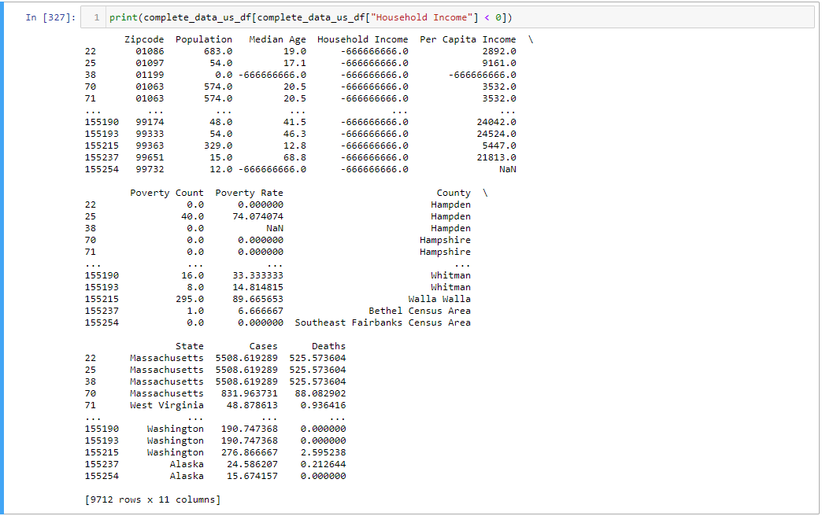
Data Exploration & Clean up
Notes:
*Move snapshot to wherever it fits into our presentation

Slide 6
Analysis Process
(show script from jupyter notebook)

Slide 7
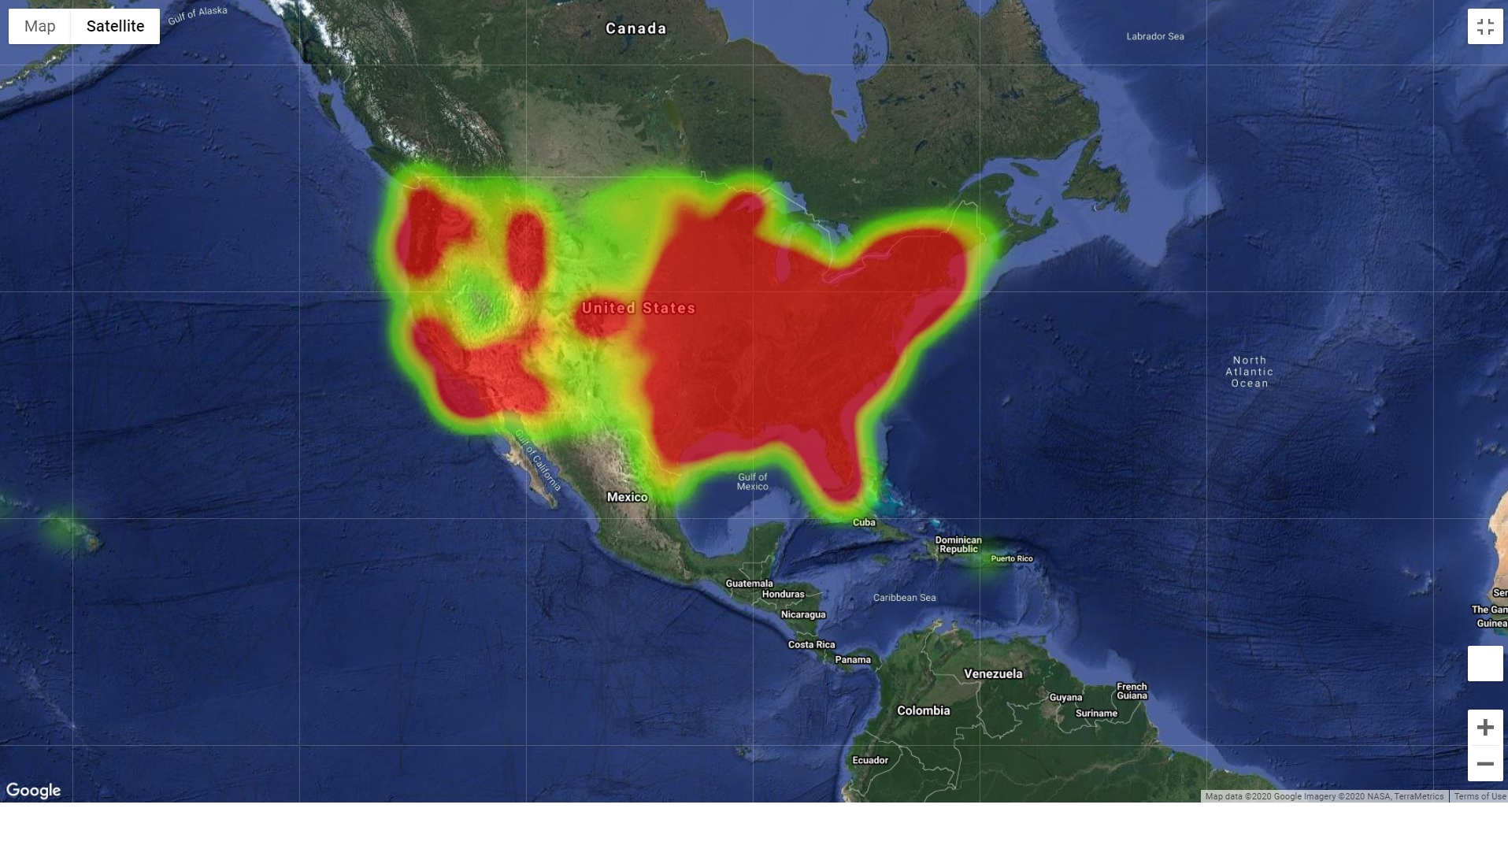

Slide 8
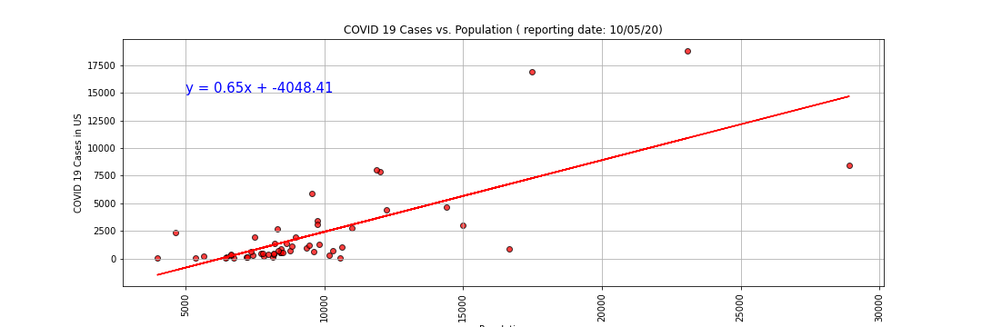
The r-value is: 0.73
There is a positive correlation between population and COVID-19 cases

Slide 9
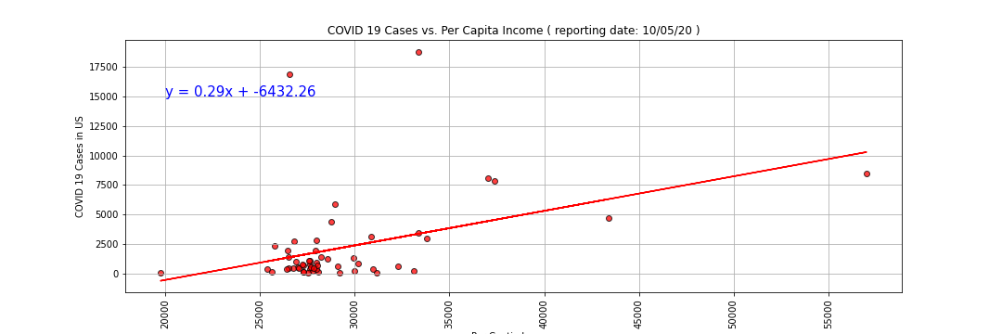
The r-value is: 0.40
Conclusion that Per Capita Income has a weak correlation.

Slide 10
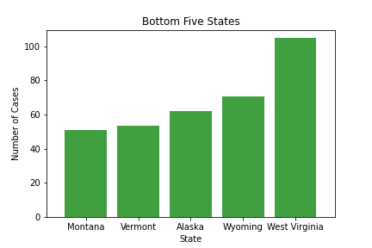
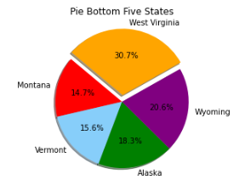
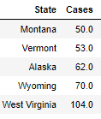
States with the least COVID-19 cases

Slide 11
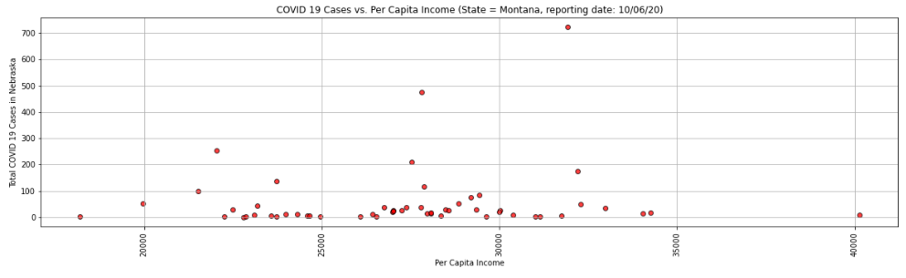
Montana (least cases in US)

Slide 12
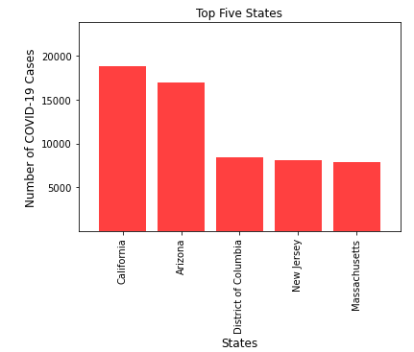
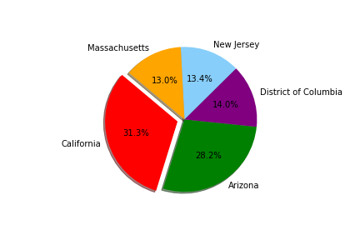
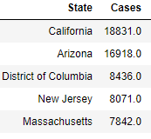
States with the most COVID-19 Cases

Slide 13
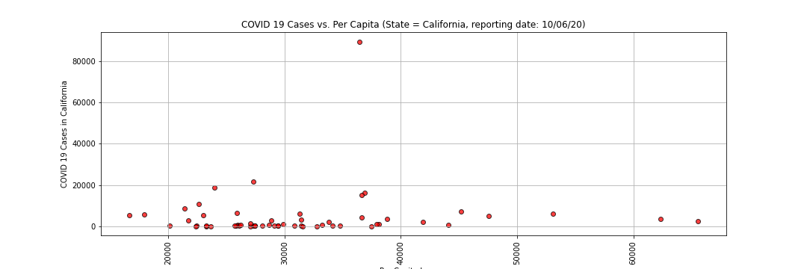
California (most cases in US)

Slide 14
What does this mean?
Is there a correlation of confirmed COVID-19 cases to HH income?

